Slide 1
Secure Data Hiding in Image Using Steganography
CAPSTONE PROJECT
Presented By:
Student Name : Sunil Kumar J
College Name & Department :
Seshadripuram College & Computer Applications

Slide 2
OUTLINE
Problem Statement
Technology used
Wow factor
End users
Result
Conclusion
Git-hub Link

Slide 3
Problem Statement
Develop a steganography system to hide and retrieve confidential data in digital images. The hidden data must be invisible to the human eye and resistant to standard image processing techniques. Ensure strong encryption for data protection and provide a user-friendly interface for encoding and decoding. The aim is to enhance data security and privacy in digital communication.

Slide 4
Technology used
Platforms:
Python Standard Library
Python IDLE Editor
ASUS Vivobook 16 laptop
Libraries:
OpenCV (cv2)
os
string
cryptography.fernet
qrcode

Slide 5
Wow factors
What makes this project stand out from other project(Unique features)
A new feature added to this project is the ability to generate a QR code containing an encrypted message. This feature stands out because it ensures security by requiring a passcode to decrypt the message, making it both innovative and user-friendly. Upon scanning the QR code, users retrieve the encrypted message, which can only be decrypted using the correct passcode, ensuring confidentiality and enhancing the project's versatility. This modern approach to encryption and secure message sharing makes the project unique and practical.

Slide 6
End users
Multinational Corporations (MNCs)
IT Companies
Government Agencies
Financial Institutions
Healthcare Providers
Media and Entertainment Companies
Educational Institutions

Slide 7
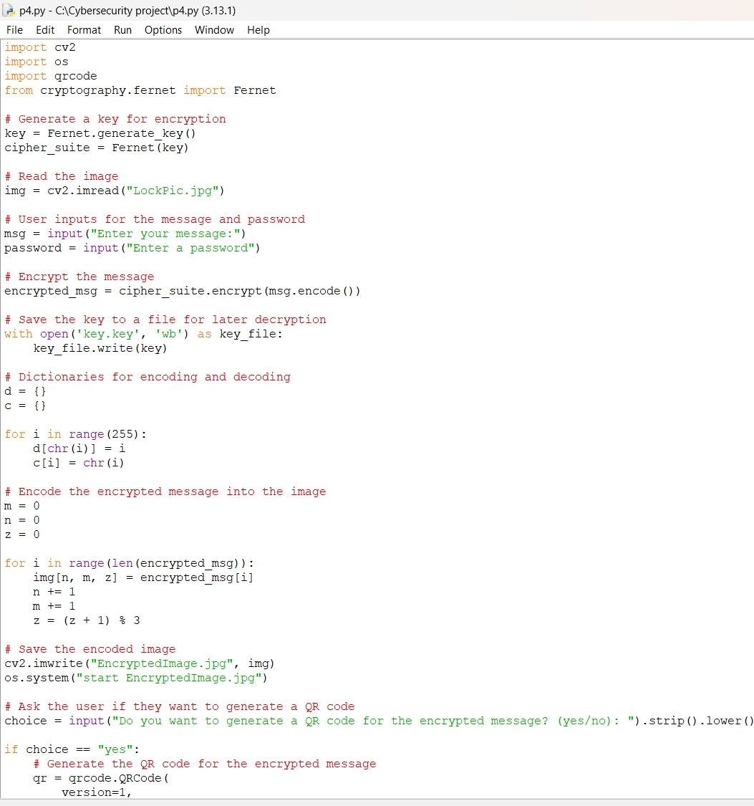
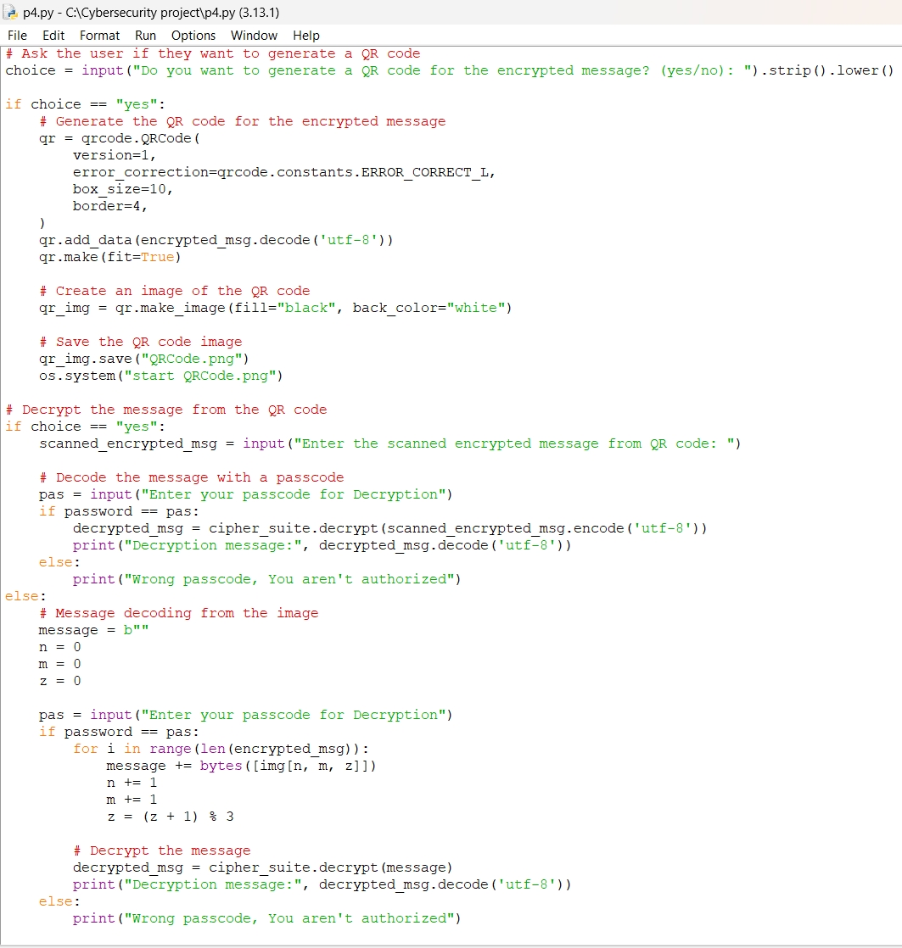
Results (screenshot of source code)

Slide 8
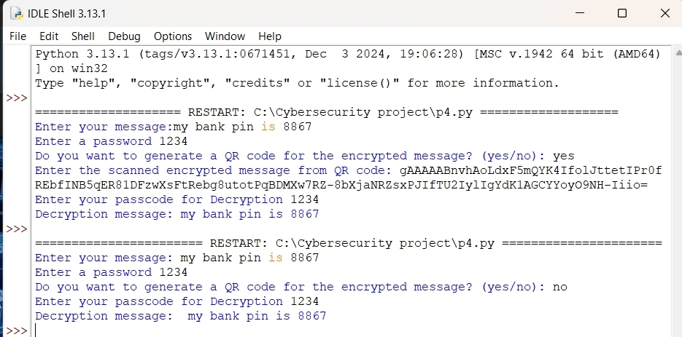
Results(code output)

Slide 9
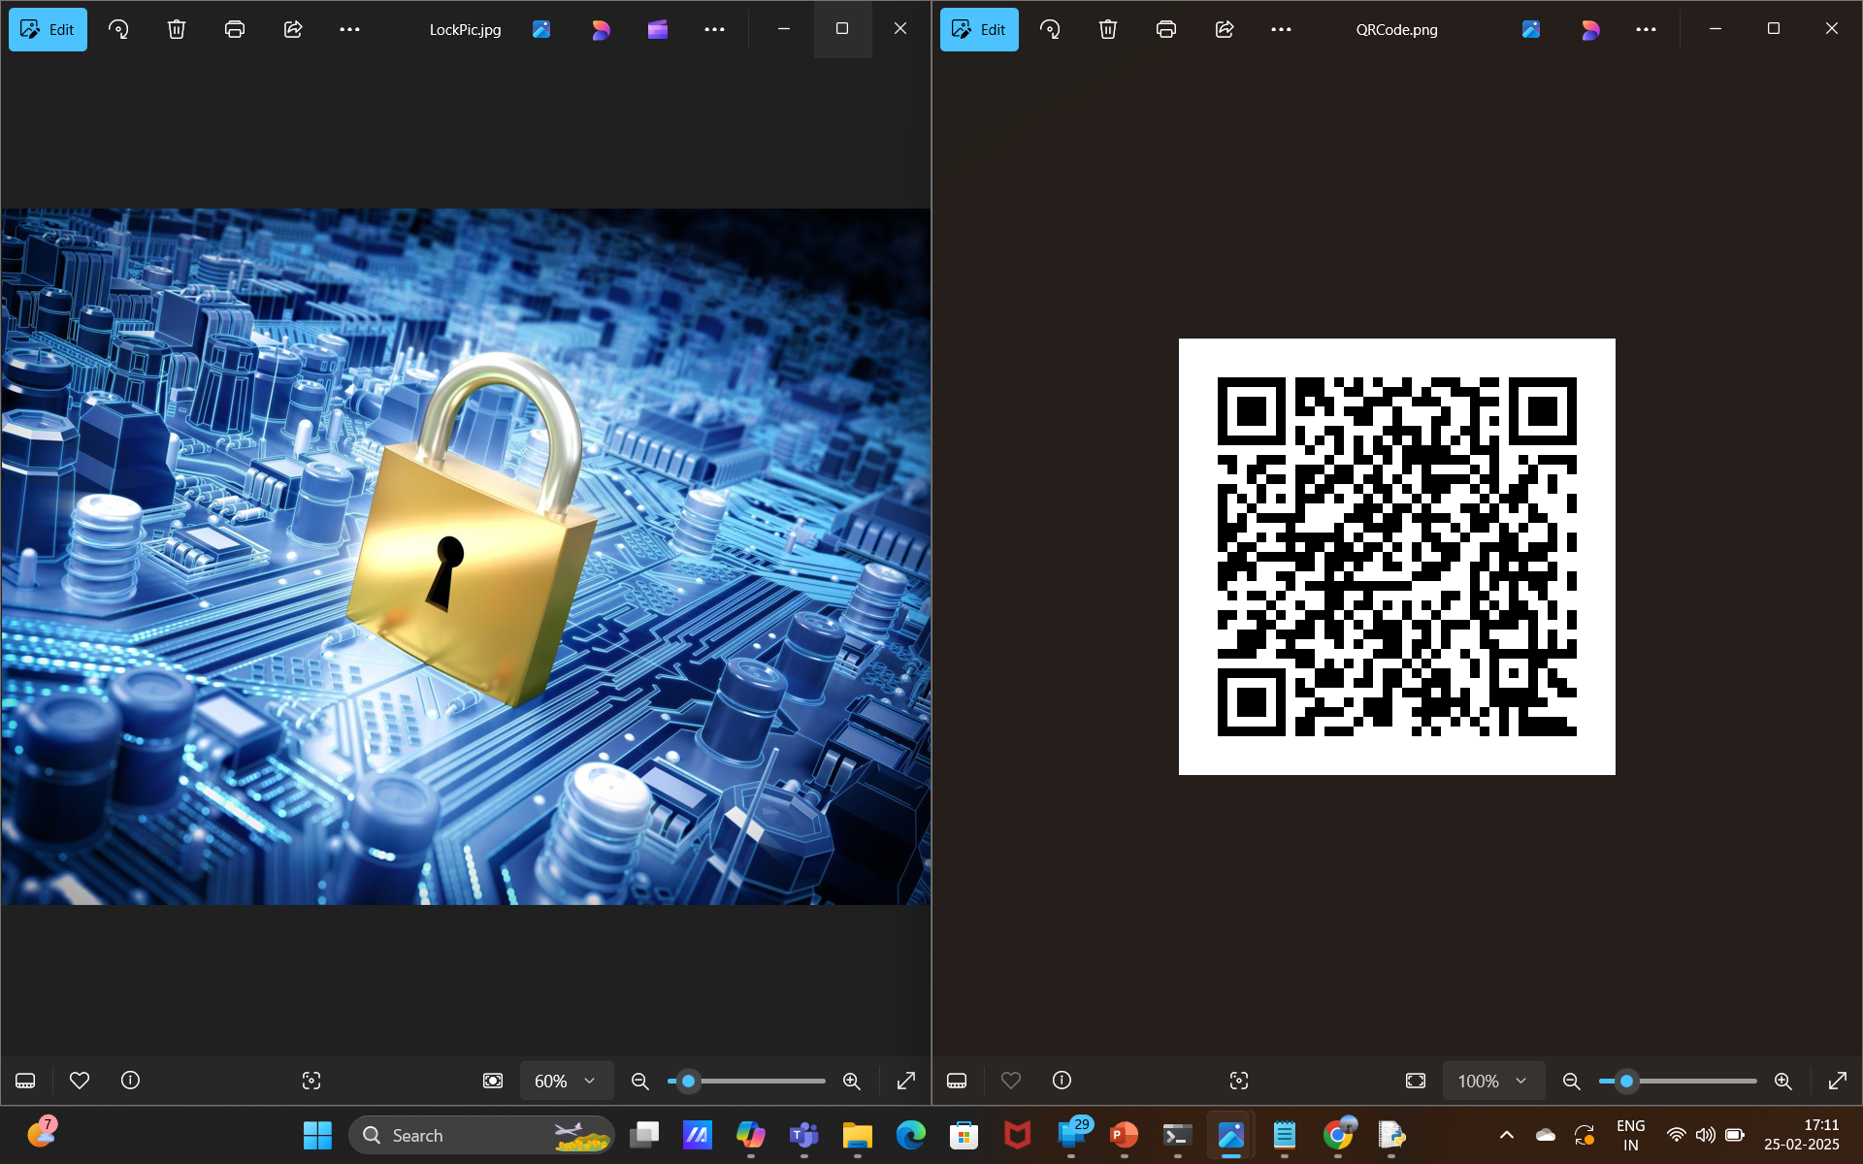
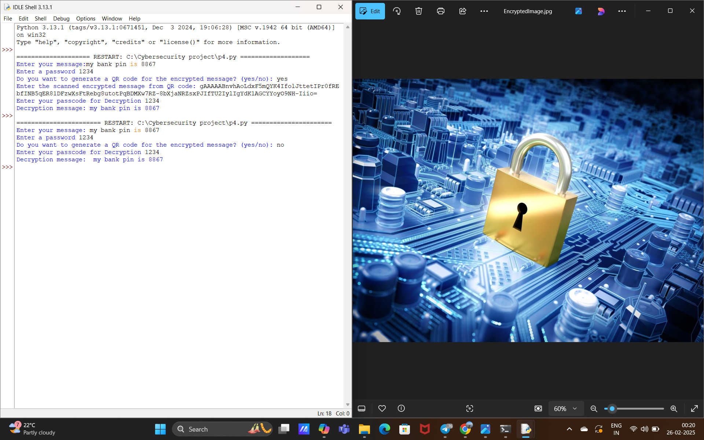
Results(outputs)

Slide 10
Conclusion
In conclusion, the developed technographic system effectively hides and retrieves confidential data within digital images, ensuring that the hidden data remains invisible to the human eye and resistant to standard image processing techniques. The integration of strong encryption safeguards the data, and the addition of the QR code feature further enhances the system's functionality by providing an innovative method for secure data sharing. By addressing the problem statement comprehensively and innovatively, this system significantly enhances data security and privacy in digital communication, making it a valuable tool for secure information sharing.

Slide 11
GitHub Link
https://github.com/sunil214-web/MySteganoProjectAicte.git
https://github.com/sunil214-web

Slide 12
THANK YOU

